Slide 1
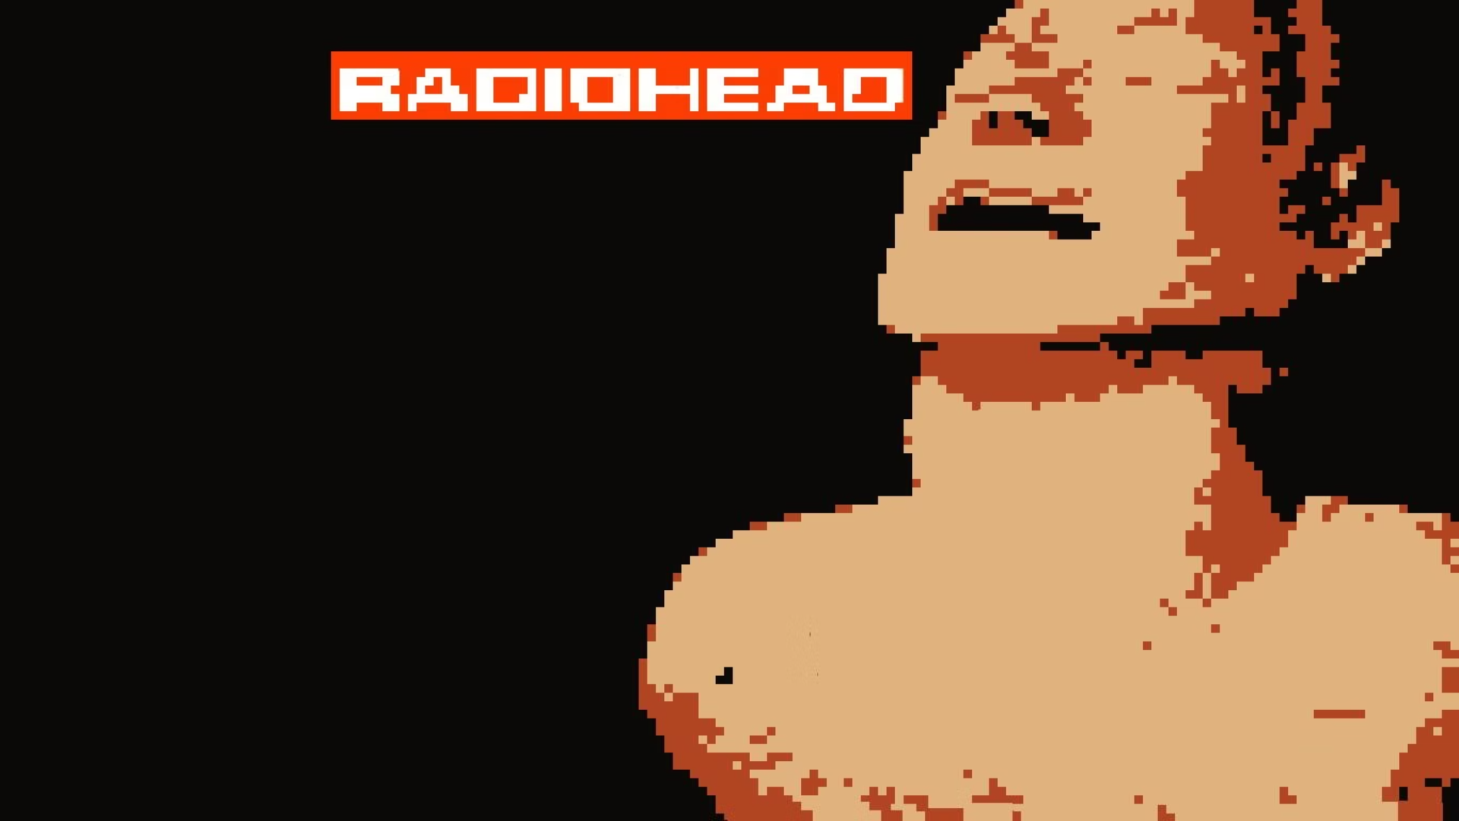



COPaine
Yes, the best name choosers are back!
In the heart of Nevada, Carl's tale unfolds—a teenager trapped in the clutches of drug abuse. Through our game, we illuminate the struggles of countless youths facing addiction's grip.
Join Carl on his journey, where he seeks redemption amidst a pixelated world, haunted by his own demons. Discover the hidden rehab vending machines scattered across the desolate landscape, offering hope amidst the haze of addiction. Through Carl's odyssey, players explore the depths of his subconscious, embarking on a journey of self-discovery and redemption through staggering game mechanics, immersive mini tasks and ultimately a finale of motivation.
by Raj Chandak

Slide 2

*Spoiler* Story:
Introduction:
Carl, the protagonist, starts at the top left corner of the map, symbolizing his journey's beginning.
Players are introduced to Carl's struggle with drug addiction and his quest for redemption.
The objective is to guide Carl through a pixelated world, seeking rehabilitation and overcoming challenges.
Exploration Phase:
Players navigate Carl through the map, exploring various locations to uncover hidden vending machines.
Vending machines contain "Rehab Juice," representing Carl's path to recovery.
Each vending machine triggers a mini-game that players must complete to obtain Rehab Juice.
Mini-Games:
Mini-games range from puzzles to reflex-based challenges, offering a diverse gameplay experience.
Successfully completing mini-games rewards players with Rehab Juice, boosting Carl's chances of rehabilitation.
Combat Encounters:
Along the journey, Carl encounters ghostly adversaries representing his inner demons.
Players engage in combat using a combination of attacks, dashes, and dodges to overcome obstacles.
Defeating demons yields rewards and clears the path for Carl's progression.
Character Progression:
Carl's health, represented by a health meter, depletes when attacked by demons.
The "High-o-Meter" fluctuates based on Carl's actions and influences background distortions.
Experience points earned from combat determine the effectiveness of Carl's attacks and abilities.
Rehabilitation Milestones:
As players collect Rehab Juice and overcome challenges, Carl's journey towards rehabilitation progresses.
Each milestone brings Carl closer to redemption, symbolized by visual and narrative cues.
Climactic Finale:
The game culminates in a climactic finale where Carl confronts his inner struggles and faces his ultimate test.
Players must utilize all acquired skills and resources to guide Carl to victory and salvation.
Resolution:
Carl's journey concludes with a resolution that reflects his growth, resilience, and newfound hope.
Players witness Carl's transformation from a troubled soul to a beacon of redemption, highlighting the game's theme of triumph over adversity.

Slide 3
Controls & Execution
Control Buttons:
Steps to Run and Execute the Game:
Movement:
Install Python and Pygame:
Arrow Keys: Move Carl in up, down, left, and right directions.
Ensure Python is installed on your system.
Abilities:
Install the Pygame library using pip: pip install pygame.
D Key: Dash to evade enemy attacks swiftly.
Download Game Files:
Shift Key: Sprint to cover long distances quickly.
Download the game files from the provided source or repository.
X Key: Use Sacred Sword
Navigate to Game Directory:
Interaction:
Open a terminal or command prompt.
Dot Key: Interact with objects, NPCs, and vending machines..
Use the cd command to navigate to the directory containing the game files.
Combat:
Mouse Click: Perform primary attacks with Carl's weapon.
Run Main.py File:
Type python main.py and press Enter to execute the main Python script.
Shift Key: Activate special sprint when available.
Game Execution:
The game window should open, displaying the title screen or intro animation.
Follow on-screen instructions to navigate menus, start the game, and control Carl.
Enjoy the gameplay experience, overcoming challenges, and guiding Carl on his journey to redemption.

Slide 4

Gameplay Mechanics
Health:
Represents the player's vitality, depleting upon enemy attacks.
When health reaches zero, the player succumbs to demons and the game ends.
High-O-Meter:
Reflects the player's mental state, influencing the game environment.
Distorted background waves correlate with the meter's level.
Experience Points (EXP):
Determines the effectiveness of the player's attacks.
Higher EXP yields more potent damage, scaled logarithmically for balance.
Player Actions:
Hit: Inflicts damage on nearby enemies, triggered by specific key input.
Dash: Enables rapid movement in a chosen direction, aiding evasion or engagement.
Sprint: Increases player speed temporarily, useful for navigating hazards.
Dodge: Executes evasive maneuvers to avoid enemy attacks, crucial for survival.
Background Distortion:
Dynamic wavy motion syncs with the player's High-O-Meter level.
Higher levels intensify the distortion, reflecting Carl's deteriorating mental state.

Slide 5
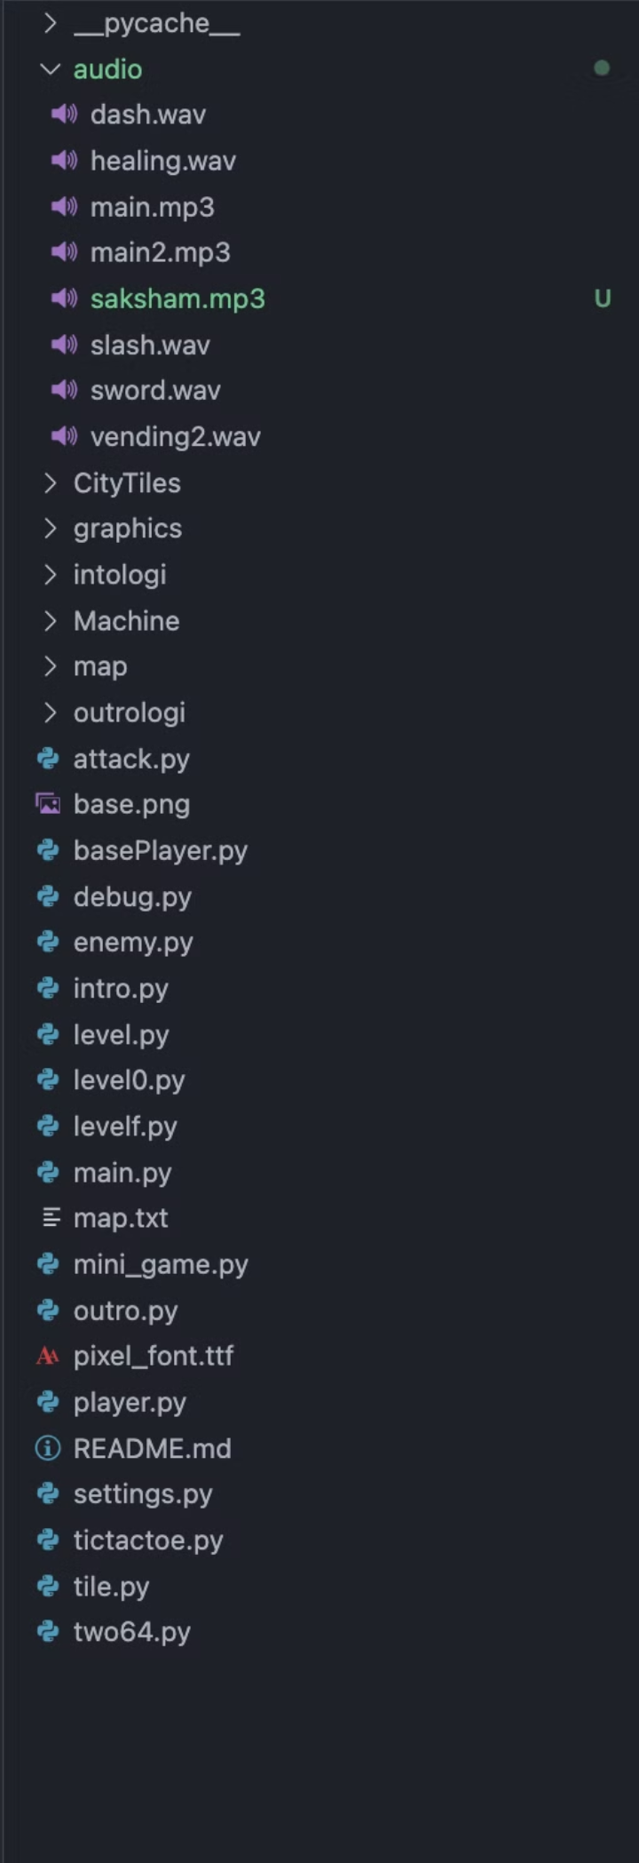
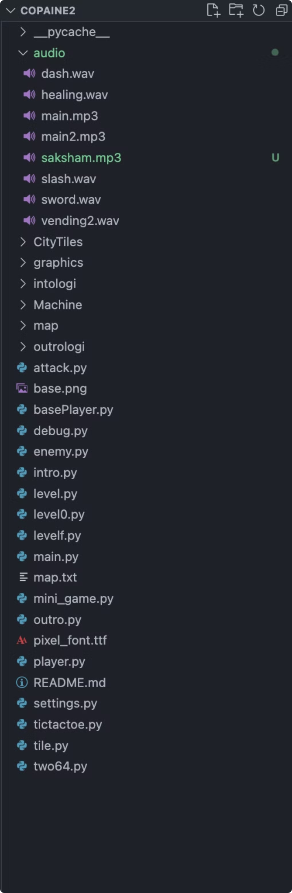
Modular Design
Our game employs a modular design approach, which enhances maintainability, scalability, and code readability. The codebase is organized into separate modules, each responsible for a specific aspect of the game, such as player controls, enemy behavior, level management, and user interface. This modular architecture allows us to develop, test, and update individual components without affecting the rest of the system.
Level:
Orchestrates game flow and environment rendering.
Utilizes Level0 for introductory sequences and Levelf for concluding scenes.
Integrates Player, Enemy, and Weapon classes to populate the game world dynamically.
Level0:
Manages the initial storyline and player introduction.
Interacts with Level to seamlessly transition into the main game.
Levelf:
Handles the final phase of the game, resolving the narrative.
Collaborates with Level for scene progression and conclusion.
Main:
Serves as the entry point for the game, orchestrating the main loop.
Integrates Level, Level0, and Levelf to structure the gameplay experience.
Player:
Represents the player character, enabling movement and interaction.
Collaborates with Level and Weapon classes for gameplay mechanics.
Enemy:
Provides antagonistic entities to challenge the player.
Interacts with Level for dynamic enemy placement and behavior.
Weapon:
Implements various armaments for the player to engage enemies.
Collaborates with Player for combat mechanics and enemy interactions.

Slide 6
Seamless transition between subgames and intro-outro
Implementation:
Design Choice:
Code Structure:
Handcrafted Pixel Art:
Intro, Main Game, and Outro classes inherit from a base Game class, ensuring consistent behavior and easy extension.
Carefully crafted pixel art images by hand, adding a personal touch and unique style.
Used Piskel, a user-friendly pixel art tool, for detailed designs and animations.
Mini-Games are standalone functions invoked at specific story points.
Original Storyline:
Execution Flow:
Developed a captivating storyline in-house, portraying Carl's struggle with drug abuse and journey to redemption.
Intro initiates the game and progresses to the Main Game upon completion.
Mini-Games trigger dynamically during the Main Game, enriching the narrative without disrupting flow.
Tailored the narrative to raise awareness about the devastating effects of addiction.
Outro activates after the Main Game, providing closure to Carl's journey.
Pixel Art Theme:
Chose a pixelated visual style to symbolize the distorted perception caused by drug intoxication.
Effortless Integration:
Each phase interacts through shared variables and events, enabling data transfer and event handling.
Pixel art evokes a sense of nostalgia and abstraction, immersing players in Carl's surreal world.
Design choices prioritize simplicity, minimizing the need for manual intervention and ensuring a seamless player experience.
Music Selection:
Selected a haunting melody that reflects the theme of eternal pain and hope for recovery.
The melancholic tones of the song complement Carl's journey, evoking emotions of despair and resilience.

Slide 7
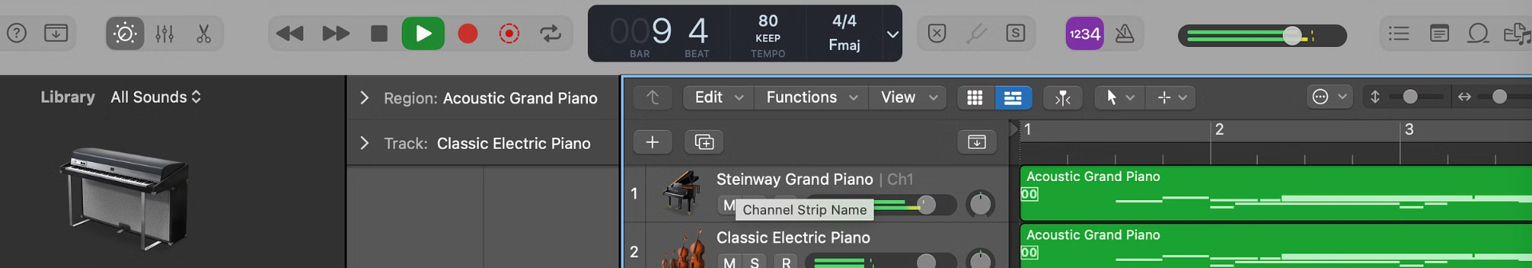
Music Design and Scoring
Conducted research on musical themes and genres that best fit the emotional tone of the game, selecting a range of tracks to convey Carl's journey.
We claim we have the best sound-scoring and the only people who have designed all of it from scratch.
Raj is the incoming Director of Instrumental Society, IIT Delhi.
We have created all music and scoring from scratch using Logic ProX and
Mixed all tracks and even generated the theme score.
Designed all sounds using modualtion softwares, can show the process in the demo.

Slide 8
Judging Parameters
Modularity
Clean Code
Creative Story
Tile and Sound Design
We have used OOPS to a beyond good threshold and are confident that a person who has no idea of the code will also describe after playing the game that an ideal code should have these particular blocks.
We believe people (CS TAs who are talented) who read the entire code for the first time will grasp the entirety of it. Usually switching back and forth from a single game is difficult, we have had 14 such transitions to states and still the game, the music , the characters all stay as they should be after the transitions.
We have tried to address a very deep social cause and believe that the story, graphics, music and the vision justify it.
We have created the map from scratch. All of the tiles, the oscillatory transparency .Yes, the sprites are taken from some resources online but even they were changed to cater to the theme of the game.
The storyline is genuinely inspiring for any person who is suffering from such intoxication habits.
We did not over complicate things and this is reflected in our code.
We also designed music from scratch and recorded using a midi and LogicProX
Types, values and enemy mechanics are also well constructed.

Slide 9
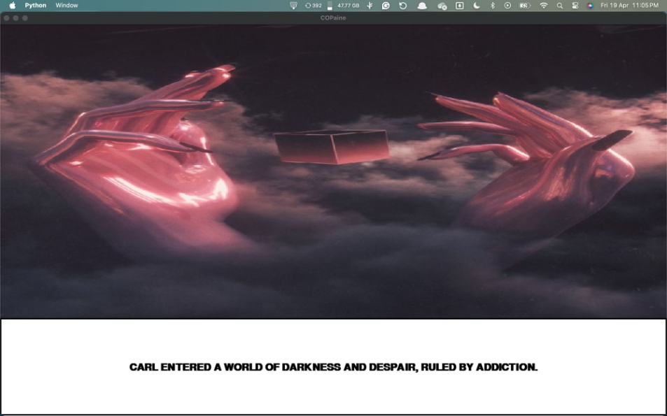
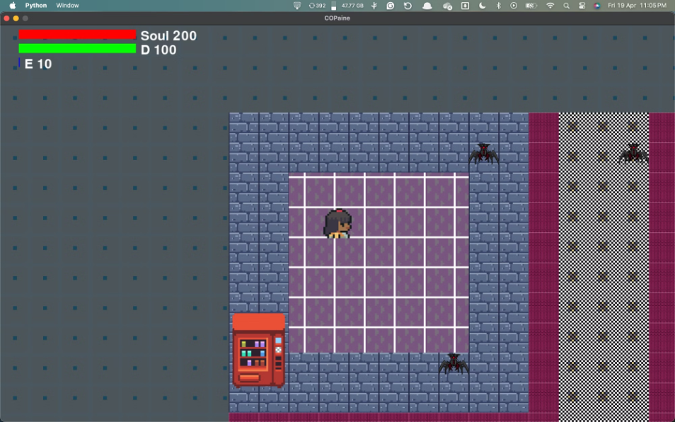
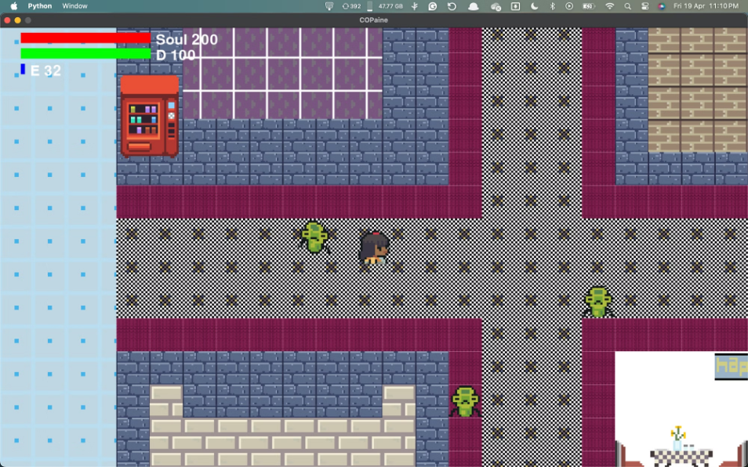
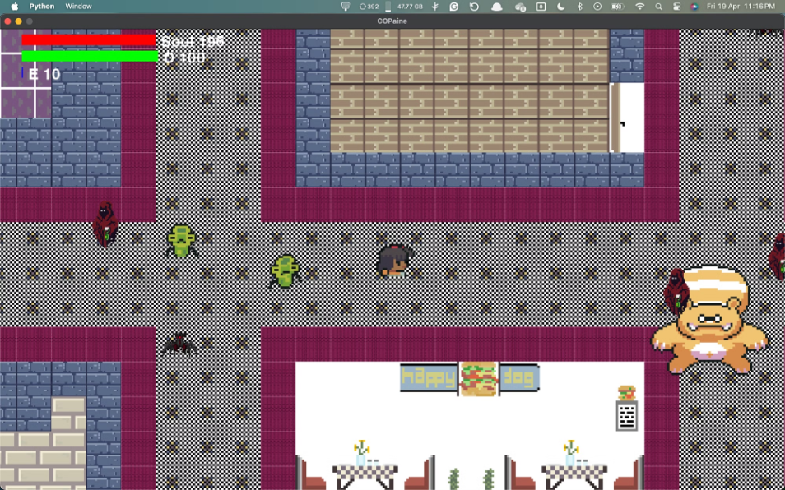
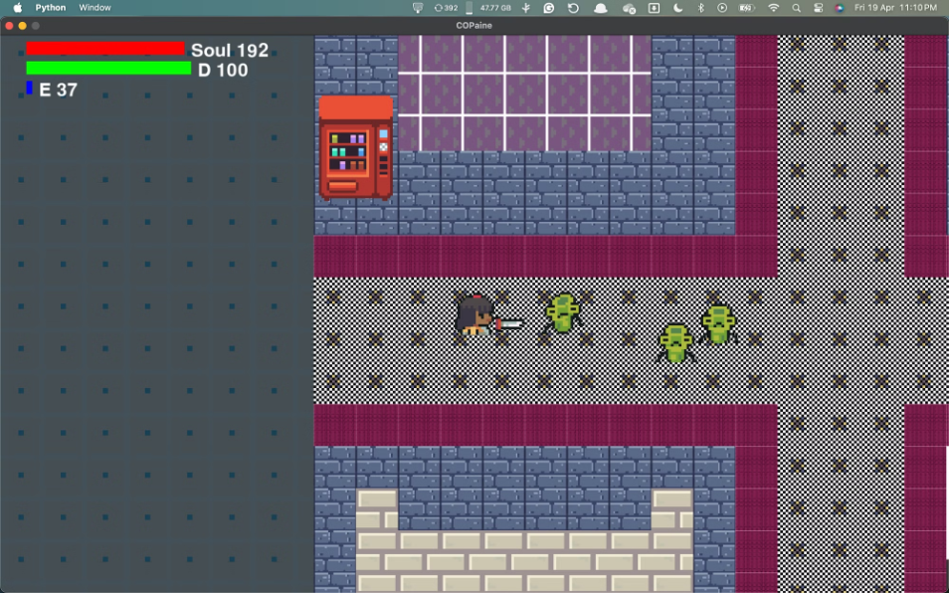
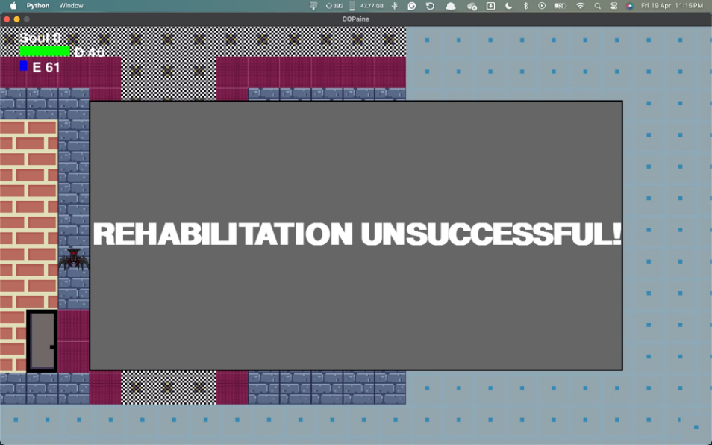
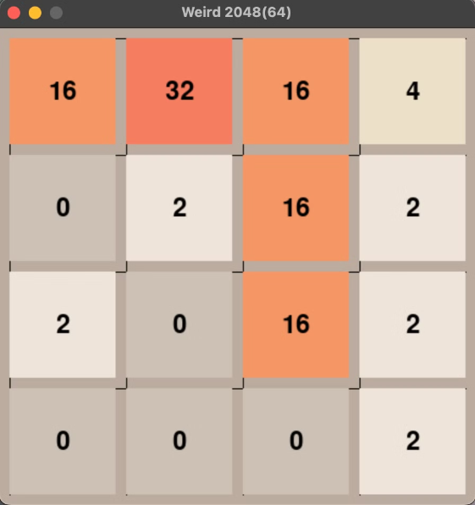
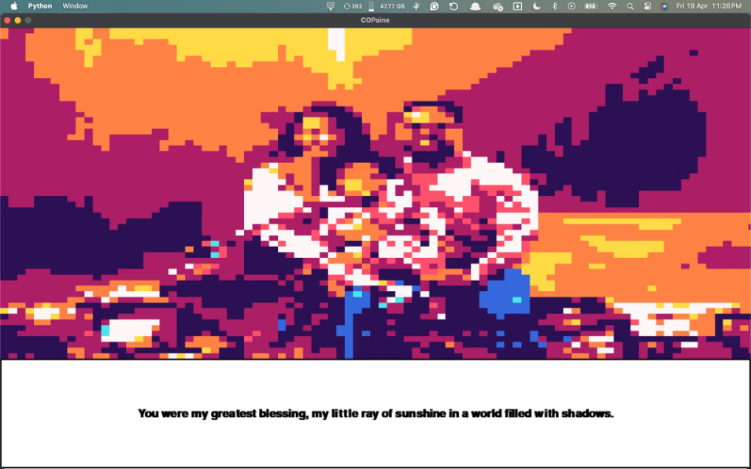
Images
Dope intro spoiler
Rendered Map
Oscillating floating background
Dash+ sprint sprite with different enemies.
My Man with his sword Arigato
Dead :(
Mini-game spoiler
Outro spoiler
THANK YOU SO MUCH !!!!!
This assignment was very very fun and hope to do a similar course either as core or elective in future !

Slide 10

Easter Eggs & Resources
Resources
Easter Eggs
1) Youtube pygame tutorial by CleanCode
1) If youve not realised, this is not a real place. It is all inside of Carl's Brain.
2) Some Spriters resources from the same as we found them perfect for a pixel-RPG game.
2)The oscillating background represents the same. it is a testimony of his perception being high 420.
3) Help from pygame manual
Pygame Front Page — pygame v2.6.0 documentation
3) The grass has both, a rehab machine as well as a healing point.
4) You are open to find more :)
Pygame
https://www.pygame.org › docs

